Slide 1
Land Based Investment Strategy: Forest For Tomorrow
5 Year Silviculture Plan Development Process
Presented by
Kevin Telfer R.P.Bio., R.P.F.
Stewardship Forester
Coast Region
Notes:
Purpose: The purpose of this presentation is:
To introduce folks to the Forests For Tomorrow 5 year silviculture plan planning process
Foster discussion between Industry and Government at the district level to indentify TSA/ TFL timber supply issues and explore options/ tools to address

Slide 2
Context
LBIS replaces previous multiple funding envelopes that were in existence prior to 2010:
Land Based Investment (LBI)
Forests for Tomorrow (FFT)
Forest investment Account (FIA)
Base funding & etc...
With a common funding and program delivery source

Slide 3
Purpose
The purpose of the 5 year silviculture plan is to identify timing and location of silviculture investments to mitigate timber supply issues and constraints, specific to each District and Management unit
Notes:
Local input (licensees, districts staff, stakeholders) into the development of the 5 silviculture plan is encouraged. This local input will be balanced with provincial and regional needs.
It is hoped that local resource needs will assist in the development of Regional and provincial goals, objectives and priorities.

Slide 4
The 2012/13-2014/15 LBIS plan identified the following silviculture investment categories as strategic priorities:
Timber Supply Mitigation
Current reforestation

Slide 5
District Role:
Lead the development of the 5 year silviculture plan in cooperation with local licensees and stakeholders
Develop budgets requests for silviculture activities
Notes:
Goals:
Maximum productivity of forest resources.
Sustainable development of forest resources.
Coordinated, integrated and sustainable management, development and use of natural resources.

Slide 6
LBIS Objectives
Objectives:
Best return from investments and activities on the forest and range land base
Prosperous forest and range rural economies
Notes:
Allocation of investments based on the following factors (in order):
magnitude of the impact in addressing the goals, objectives, and strategic priorities resulting from the activity;
multiple benefits that can be achieved from the activity;
activities that address structural timber supply or ecological integrity issues;
activities that are dependant on a specific biological window for success.
strength of evidence that the expenditure will have the impact that is claimed.

Slide 7
LBIS Objectives
Strategic Priorities:
Manage impacts on forest and range resources from pests, disease, and wildfire.
Mitigate mid-term timber supply shortfalls.
Maximize timber growth in the provincial forests.

Slide 8
LBIS Objectives
Priority will be given to activities that:
address critical mid-term time periods when second growth timber must be available in sufficient quantities and size to meet supply demands,
reforest catastrophic disturbance where mid and long-term timber supply has been impacted
protection of mid and long-term timber supply from potential catastrophic disturbance
Notes:
Catastrophic disturbance is usually associated with wildfire.

Slide 9
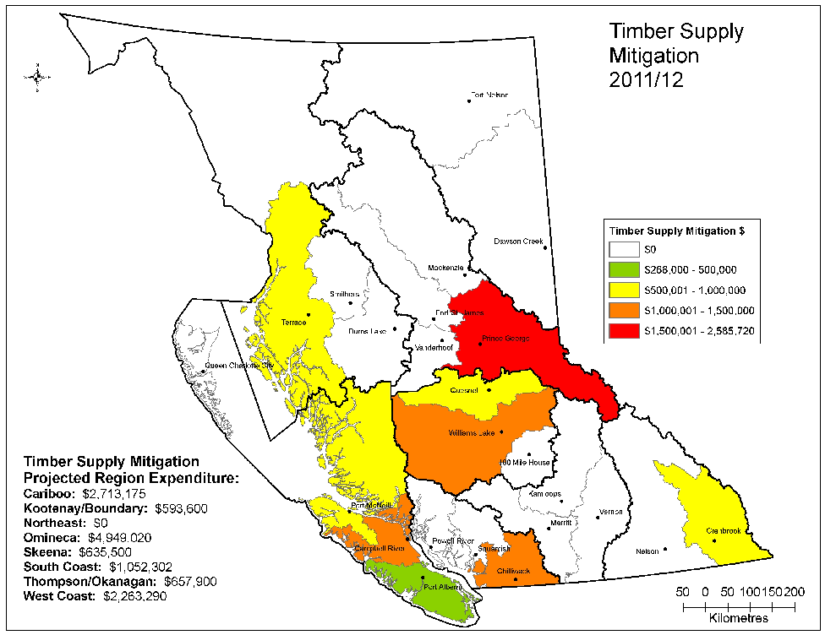
Timber supply mitigation:
Enhanced stock
Spacing
Fertilization
Pruning
Notes:
Timber supply mitigation is especially focused on those management units where there is a documented and projected mid term timber supply fall down (20-30 years out)

Slide 10
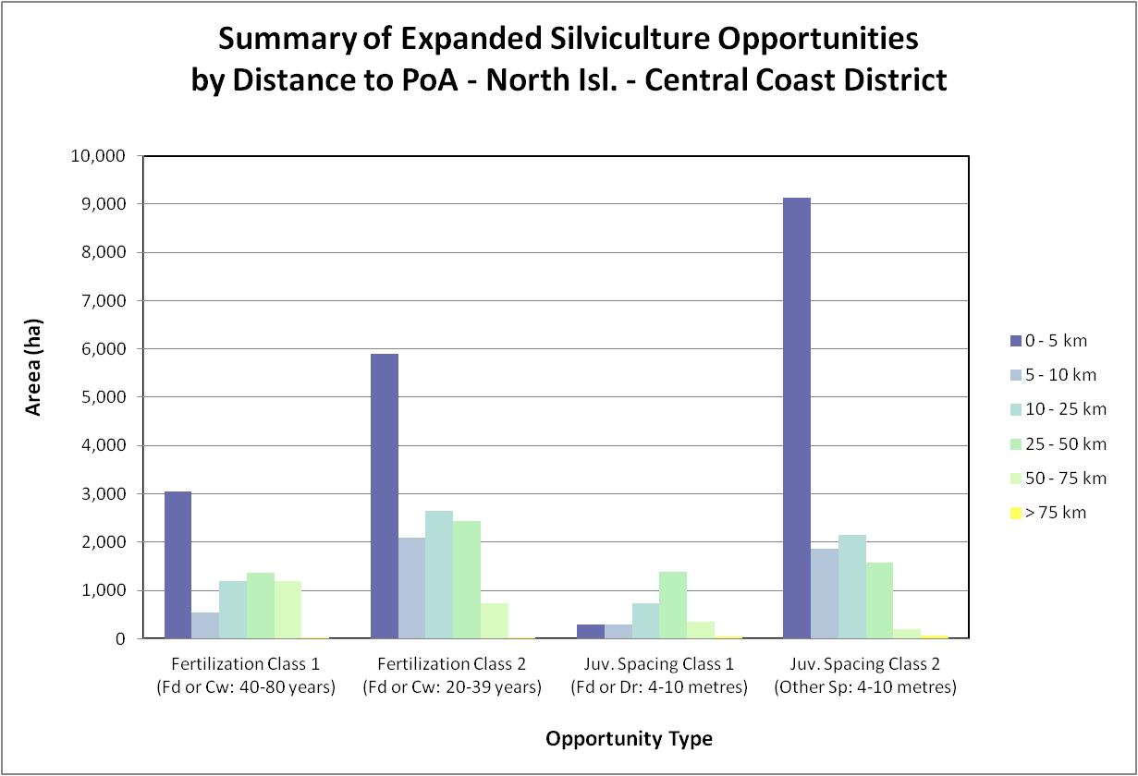
Notes:
The next five slides indicate silviculture opportunities by district (emphasis on return and distance to POA), and will be selected for the FMLT being addressed

Slide 11
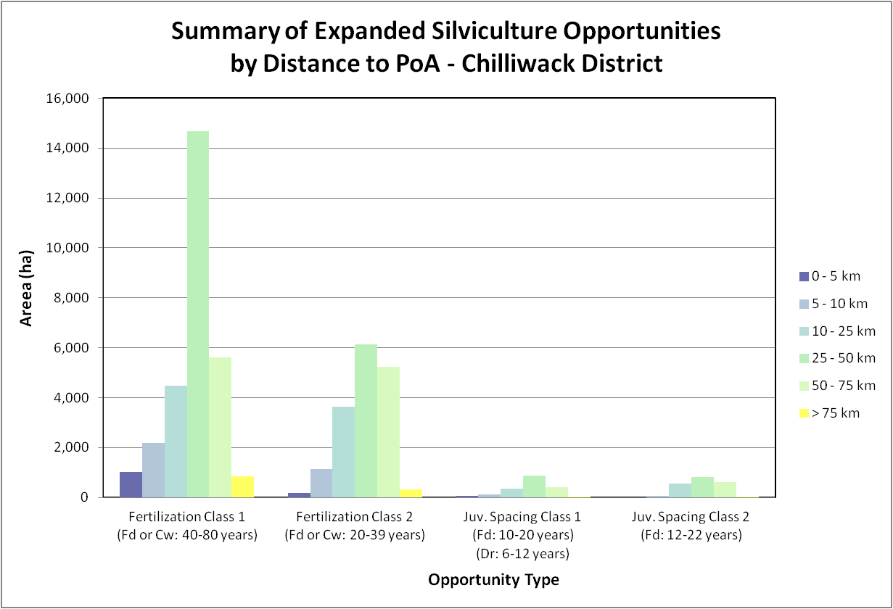

Slide 12
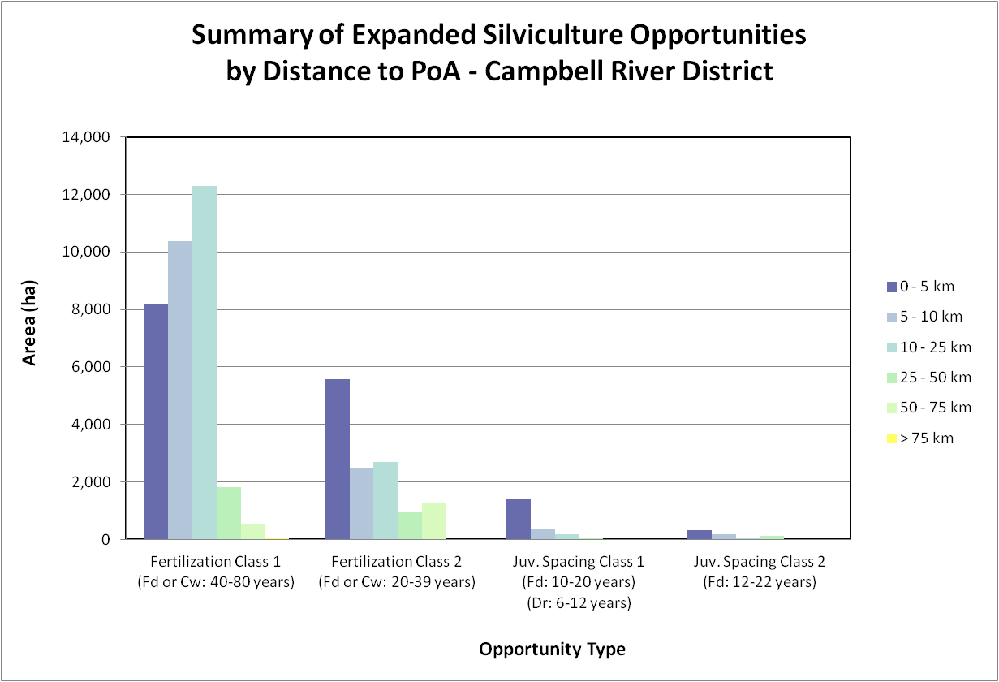
Notes:
Keep for Campbell River presentation only

Slide 13
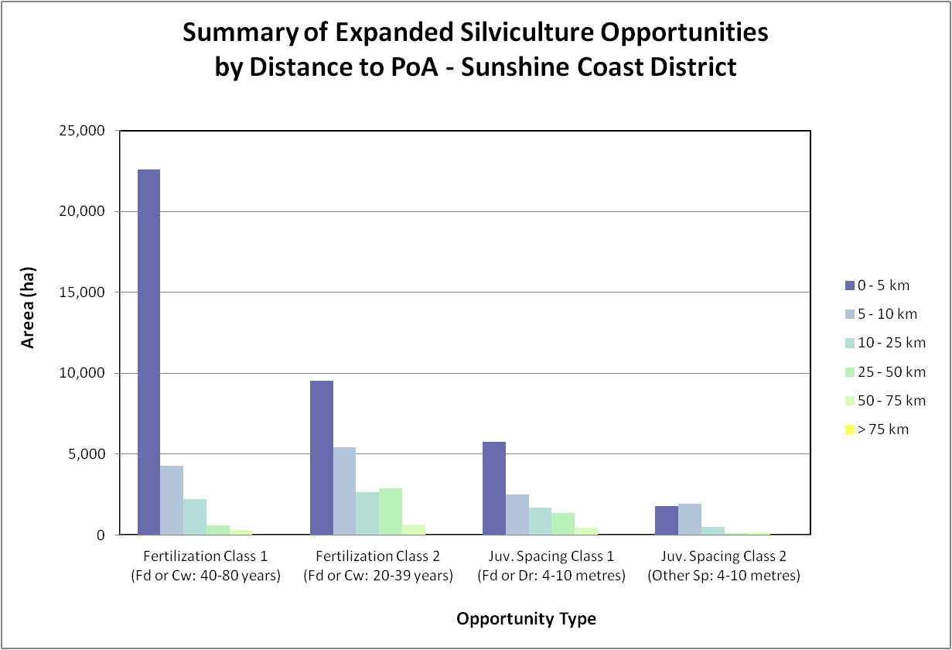
Notes:
Sunshine Coast Presentation

Slide 14
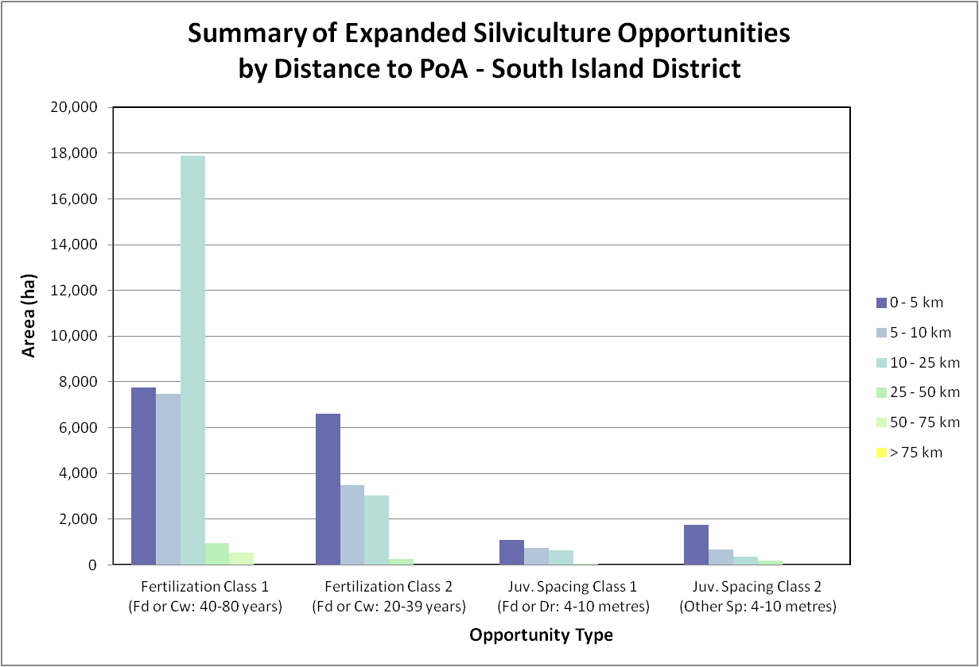
Notes:
For South Island Presentation

Slide 15
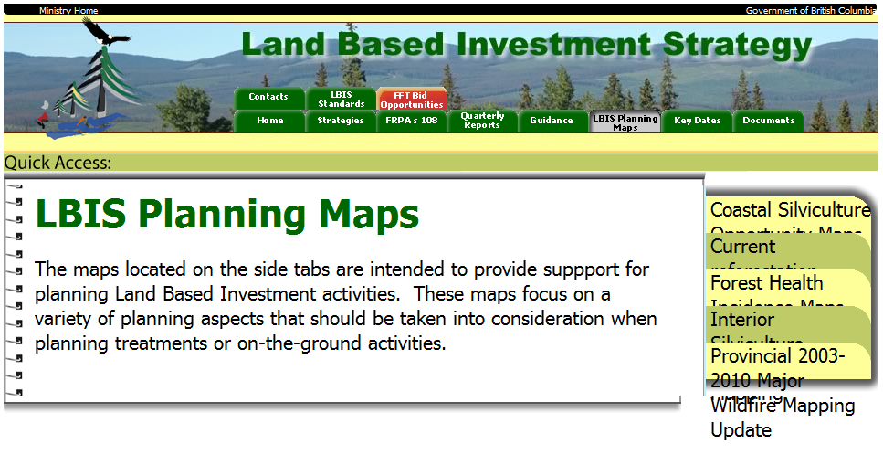
Information sources to guide plan development:
Silviculture Opportunity maps
TSR Analysis Reports
Wildfire mapping
Forest Health mapping
RESULTS reporting of planned activities

Slide 16
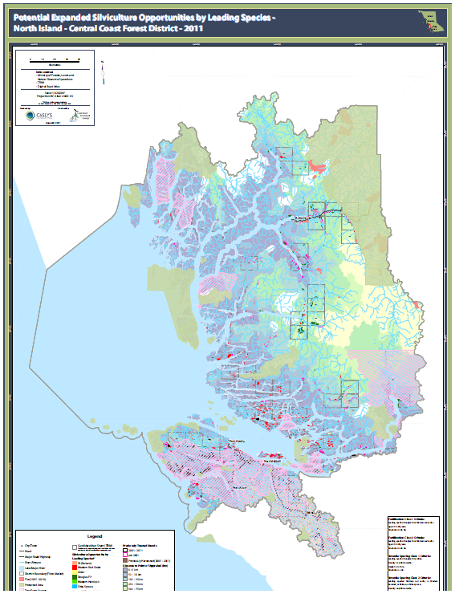
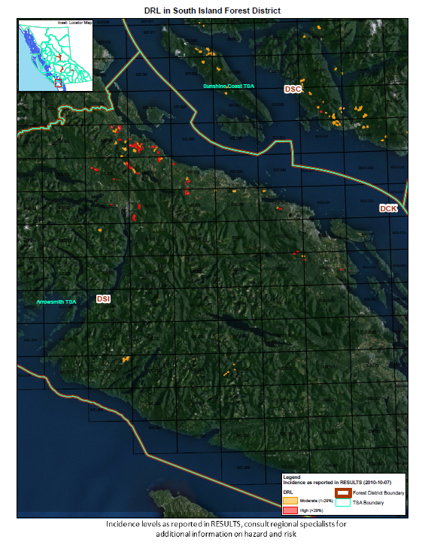
Silviculture Opportunity Mapping
Forest Health Mapping

Slide 17
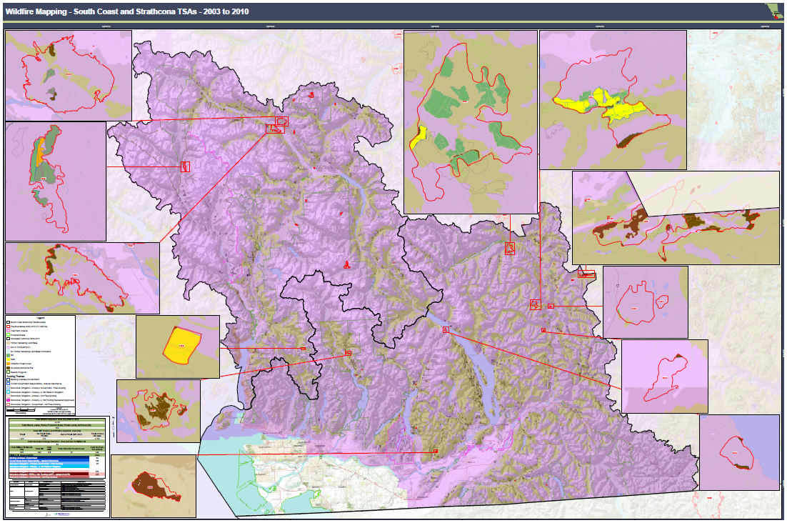
South Coast and Strathcona TSA Fire mapping
Notes:
LBIS Fire mapping is another Resource for silviculture opportunities. The wildfire mapping shows the location of all wildfires between 2003 and 2010.

Slide 18
Silviculture and Timber Supply strategies are available on the LBIS webpage and show incremental silviculture and fertilization opportunities, RESULTS tables and TSR implications:
http://lbis.forestpracticesbranch.com/LBIS/node/58
Notes:
Open link to Sunshine Coast TSA Silviculture “Strategies at a Glance” and quickly scroll through strategies and TSR implications

Slide 19
Category | Planned Funding
Activity | 2012 / 2013 | 2013 / 2014 | 2014 / 2015 | 2015 / 2016 | 2016 / 2017 | Total $$
Current Reforestation
Surveys (Backlog NSR ) | $ 45,000 | $ - | $ - | $ - | $ - | $ 45,000
Surveys and Overview Planning |  |  |  |  |  | $ -
a) MPB | $ - | $ - | $ - | $ - | $ - | $ -
b) Wildfire | $ 71,500 | $ 550 | $ - | $ - | $ - | $ 72,050
c)Non_Obligation NSR
d) Stand Maintenance SU
Site Preparation | $ - | $ - | $ - | $ - | $ - | $ -
Brushing | $ - | $ - | $ - | $ - | $ - | $ -
Planting (Seedlings) | $ - | $ 90,060 | $ - | $ - | $ - | $ 90,060
Timber Supply Mitigation
Surveys and Overview Planning | $ 520,500 | $ 573,000 | $ 633,000 | $ 663,000 | $ 663,000 | $ 3,052,500
Brushing / Cleaning | $ 82,338 | $ 82,338 | $ 41,169 | $ - | $ - | $ 205,846
Spacing | $ 93,283 | $ 466,414 | $ 2,891,765 | $ 4,291,007 | $ 4,291,007 | $ 12,033,475
Fertilization | $ 863,332 | $ 1,015,685 | $ 1,625,096 | $ 1,675,880 | $ 1,777,449 | $ 6,957,442
Pruning | $ - | $ - | $ - | $ - | $ - | $ -
Additional Activities
Infrastructure _Roads
Sowing $$ | $ 24,780 | $ - | $ - | $ - | $ - | $ -
Total
GRAND TOTAL | $ 1,700,733 | $ 2,228,047 | $ 5,191,030 | $ 6,629,887 | $ 6,731,455 | $ 22,456,373
West Coast Planned Funding in Current 5 Year Silviculture Plan
Notes:
West Coast Presentation
Fertilization example:
Kingcome TSA/TFL 39/TFL6→ each to fertilize 500 ha, @ $101,000 each

Slide 20
 |  |  | Total Goals for West Coast
Category | Planned Goals |  |  |  |  |  | Unit Costs
Activity | 2012 / 2013 | 2013 / 2014 | 2014 / 2015 | 2015 / 2016 | 2016 / 2017 | Total
Current Reforestation (ha/trees)
Surveys (Backlog NSR ) | 1500 |  |  |  |  |  | 30
Surveys and Overview Planning
a) MPB |  |  |  |  |  |  | 55
b) Wildfire | 1300 | 10 | 0 | 0 | 0 |  | 55
c)Non_Obligation NSR
d) Stand Maintenance SU
Site Preparation |  |  |  |  |  |  | 350
Brushing |  |  |  |  |  |  | 762
Planting (Trees) | - | 158,000 | - | - | - |  | 0.57
Sowing (Trees) | 118,000 | - | - | - | - |  | 0.21
Timber Supply Mitigation (ha)
Surveys and Overview Planning | 17350 | 19100 | 21100 | 22100 | 22100 | 101,750 | 30
Brushing / Cleaning | 100 | 100 | 50 | 0 | 0 | - | 823
Spacing | 50 | 250 | 1550 | 2300 | 2300 | 6,450 | 1866
Fertilization | 4250 | 5000 | 8000 | 8250 | 8750 | 34,250 | 203
Pruning | 0 | 0 | 0 | 0 | 0 | - | 2046
 |  |  |  |  |  | -
West Coast Planned Activities in Current 5 Year Silviculture Plan

Slide 21
Category | Planned Funding
Activity | 2012 / 2013 | 2013 / 2014 | 2014 / 2015 | 2015 / 2016 | 2016 / 2017 | Total $$
Current Reforestation
Surveys (Backlog NSR ) | $ 45,000 | $ - | $ - | $ - | $ - | $ 45,000
Surveys and Overview Planning |  |  |  |  |  | $ -
a) MPB | $ - | $ - | $ - | $ - | $ - | $ -
b) Wildfire | $ 33,000 | $ 1,100 | $ - | $ - | $ - | $ 34,100
c)Non_Obligation NSR
d) Stand Maintenance SU
Site Preparation | $ - | $ - | $ - | $ - | $ - | $ -
Brushing | $ 12,600 | $ - | $ - | $ - | $ - | $ 12,600
Planting (Seedlings) | $ - | $ 26,790 | $ - | $ - | $ - | $ 26,790
Timber Supply Mitigation
Surveys and Overview Planning | $ 174,600 | $ 222,600 | $ 270,600 | $ 285,600 | $ 708,600 | $ 1,662,000
Brushing / Cleaning | $ 23,055 | $ - | $ - | $ - | $ - | $ 23,055
Spacing | $ 652,979 | $ 93,283 | $ 1,268,645 | $ 2,294,756 | $ 2,294,756 | $ 6,604,419
Fertilization | $ 412,368 | $ 412,368 | $ 615,505 | $ 666,289 | $ 717,074 | $ 2,823,604
Pruning | $ - | $ - | $ - | $ - | $ - | $ -
Additional Activities
Infrastructure _Roads
Sowing $$ | $ - | $ - | $ - | $ - | $ - | $ -
Total
GRAND TOTAL | $ 1,353,602 | $ 756,141 | $ 2,154,751 | $ 3,246,645 | $ 3,720,429 | $ 11,231,568
South Coast Planned Funding in Current 5 Year Silviculture Plan
Notes:
South Coast Presentation

Slide 22
 |  |  | Total Goals for South Coast
Category | Planned Goals |  |  |  |  |  | Unit Costs | Comments (Estimated MPB / WF)
Activity | 2012 / 2013 | 2013 / 2014 | 2014 / 2015 | 2015 / 2016 | 2016 / 2017 | Total
Current Reforestation (ha/trees)
Surveys (Backlog NSR ) | 1500 |  |  |  |  |  | 30
Surveys and Overview Planning
a) MPB |  |  |  |  |  |  | 55
b) Wildfire | 600 | 20 | 0 | 0 | 0 |  | 55
c)Non_Obligation NSR
d) Stand Maintenance SU
Site Preparation |  |  |  |  |  |  | 350
Brushing | 28 |  |  |  |  |  | 450 | TSA 30 Aerial Herbicide
Planting (Trees) | - | 47,000 | - | - | - |  | 0.57
Sowing (Trees) | - | - | - | - | - |  | 0.21
Timber Supply Mitigation (ha)
Surveys and Overview Planning | 5820 | 7420 | 9020 | 9520 | 23620 | 55,400 | 30
Brushing / Cleaning | 28 | 0 | 0 | 0 | 0 | - | 823
Spacing | 350 | 50 | 680 | 1230 | 1230 | 3,540 | 1866
Fertilization | 2030 | 2030 | 3030 | 3280 | 3530 | 13,900 | 203
Pruning | 0 | 0 | 0 | 0 | 0 | - | 2046
 |  |  |  |  |  | -
South Coast Planned Activities in Current 5 Year Silviculture Plan
Notes:
South Coast presentation

Slide 23
Key timing dates for LBIS:
  June→ begin planning next fiscal LBIS with input from District staff & FMLT’s
  July 1st → Regional staff use input to draft 5 yr plan
  Sept 15th → deadline for 5 year LBIS plan
  November 1st → submit draft of next fiscal to FLNRO executive for budgeting
  Dec 6th → Last day to have full investment schedule
  March 26th →Last day to complete fiscal year projects
  March 1st → Release next fiscal LBIS budget

Slide 24
In summary:
Do FMLT members think different treatment/spending priorities would be more appropriate?
If so, FMLTs are invited to suggest changes to the 5 year LBIS Plan

Slide 25

Thank you

Slide 26
Questions?

